Slide 1
INT 219: FRONT END WEB DEVELOPER UNIT III Working with jQuery and JSON
Content created by
Amanpal Singh on [10/01/15]

Slide 2
Table of content
Basics of jQuery
jQuery Events
Benefits of using CDN
jQuery Selectors
jQuery input vs :input
jQuery DOM manipulation methods
jQuery Elements
Working with JSON Objects
JSON Arrays
Nested JSON object
Conversion of JSON object to string, Conversion of string to JSON object

Slide 3
1. Basics of jQuery
Lightweight, "write less, do more", JavaScript library.
Simplifies a lot of the complicated things from JavaScript.
Ways to add jQuery to Your Web Pages
Download the jQuery library from jQuery.com
Include jQuery from a CDN, like Google

Slide 4
The jQuery library contains the following features:
HTML/DOM manipulation
CSS manipulation
HTML event methods
Effects and animations
AJAX
Utilities

Slide 5
Download method:
<head><script src="jquery-3.7.1.min.js"></script></head>
CDN method:
<head>
<script
src="https://ajax.googleapis.com/ajax/libs/jquery/3.7.1/jquery.min.js">
</script>
</head>

Slide 6
The jQuery syntax
Tailor-made for selecting HTML elements &
performing some action on the element(s).
Basic syntax is: $(selector).action()
A $ sign to define/access jQuery
A (selector) to "query (or find)" HTML elements
A jQuery action() to be performed on the element(s)

Slide 7
The Document Ready Event
all jQuery methods is inside a document ready event
$(document).ready(function(){
// jQuery methods go here...
});
to prevent execution of jQuery code before the document loads.

Slide 8
2. jQuery Events
Common DOM events:
Mouse Events | Keyboard Events | Form Events | Document/Window Events
click | keypress | submit | load
dblclick | keydown | change | resize
mouseenter | keyup | focus | scroll
mouseleave |  | blur | unload
Refer the link for detail implementation: https://www.geeksforgeeks.org/jquery-events/

Slide 9
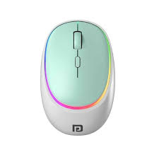
2.1 Mouse Events

Slide 10
click()
<head>
<script src="https://ajax.googleapis.com/ajax/libs/jquery/3.7.1/jquery.min.js"></script>
<script>
$(document).ready(function(){
$("p").click(function(){
$(this).hide();
}); });
</script> </head>
The $(document).ready() method:
allows us to execute a function
when the document is fully loaded.

Slide 11
Dbl click
<script>
$(document).ready(function(){
$("p").dblclick(function(){
$(this).hide();
});
});
</script>

Slide 12
Mouse enter
<script>
$(document).ready(function(){
$("#p1").mouseenter(function(){
alert("You entered p1!");
});
});
</script>
<p id="p1">If you click on me, I will disappear.</p>

Slide 13
Mouse leave
<script>
$(document).ready(function(){
$("#p1").mouseleave(function(){
alert("You left p1!");
});
});
</script>
<p id="p1">If you click on me, I will disappear.</p>

Slide 14
Mouse Down
<script>
$(document).ready(function(){
$("#p1").mousedown(function(){
alert("You left p1!");
});
});
</script>
<p id="p1">If you click on me, I will disappear.</p>

Slide 15
Mouse up
<script>
$(document).ready(function(){
$("#p1").mouseup(function(){
alert("You left p1!");
});
});
</script>
<p id="p1">If you click on me, I will disappear.</p>

Slide 16
hover()
It takes two functions / methods .
A combination of the mouseenter() and mouseleave().
first function is executed when the mouse enters…
<script>
$(document).ready(function(){
$("#p1").hover(
function(){ alert("You entered p1!"); } ,
function(){ alert("Bye! You now leave p1!");}
);
});
</script>
<p id="p1">If you click on me, I will disappear.</p>

Slide 17
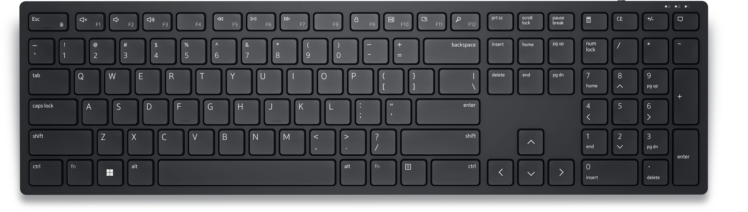
2.2 Keyboard Events

Slide 18
keypress
<head><script src="https://ajax.googleapis.com/ajax/libs/jquery/3.7.1/jquery.min.js"></script>
<script> i = 0;
$(document).ready(function(){
$("input").keypress(function(){
$("#p1").text(i += 1);
}); });
</script> </head> <body> Enter input: <input type="text">
<p id="p1">If you click on me.</p>
It will not fired for all keys (e.g. ALT, CTRL, SHIFT, ESC).
Use the keydown() method to check these keys.

Slide 19
keydown
<head><script src="https://ajax.googleapis.com/ajax/libs/jquery/3.7.1/jquery.min.js"></script>
<script> i = 0;
$(document).ready(function(){
$("input").keydown(function(){
$("#p1").text(i += 1);
}); });
</script> </head> <body> Enter input: <input type="text">
<p id="p1">If you click on me.</p>

Slide 20
keyup
<head><script src="https://ajax.googleapis.com/ajax/libs/jquery/3.7.1/jquery.min.js"></script>
<script> i = 0;
$(document).ready(function(){
$("input").keyup(function(){
$("#p1").text(i += 1);
}); });
</script> </head> <body> Enter input: <input type="text">
<p id="p1">If you click on me.</p>
It only count the up movement.
Count 1 for long press.

Slide 21
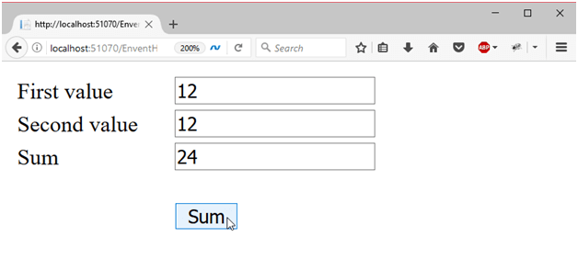
2.3 Form Events

Slide 22
submit
<script>
$(document).ready(function () {
$("form").submit(function () {
alert("Form submitted Successfully");
});
});
</script> </head> <body> <form action=""> Enter input: <input type="text"> <input type=submit value="Submit"> </form>

Slide 23
focus() , blur()
<script>
$(document).ready(function(){
$("input").focus(function(){
$(this).css("background-color", "yellow");
});
$("input").blur(function(){
$(this).css("background-color", "green");
});
});
</script>
focus(): executed when the form field gets focus
blur(): executed when the form field loses focus

Slide 24
change
<script>
$(document).ready(function(){
$("input").change(function () {
$(this).css("background-color", "#7FFF00");
});
});
</script>

Slide 25
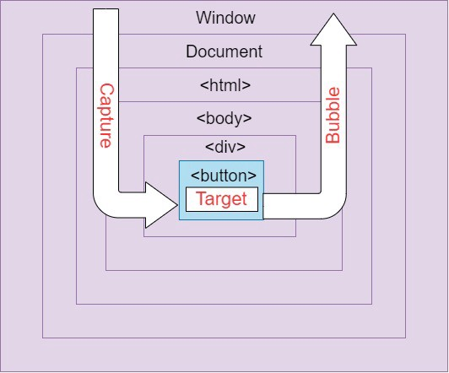
2.4 Document/Window Events

Slide 26
jQuery load() Method
helps to load data from the server &
returned it to the selected element
without loading the whole page
Parameters
url − URL to which the request is sent.
data − map of data that is sent with the request. [optional]
callback − represents a function that is executed if the request succeeds [optional]

Slide 27
load
<head> <script src="https://ajax.googleapis.com/ajax/libs/jquery/3.3.1/jquery.min.js"></script>
<script>
$(document).ready(function () {
$("button").click(function () {
$("#xx").load("abc.txt", function(response, status, xhr) {
if (status == "error") {
$("#xx").html("An error occurred: " + xhr.status + " " + xhr.statusText);
} }); }); }); </script> </head>

Slide 28
resize
<script>
var x = 0;
$(document).ready(function(){
$(window).resize(function(){
$("#xx").text(x += 1);
});
});
</script>
<body> <div id="xx">data</div> </body>

Slide 29
scroll
<script> var x = 0;
$(document).ready(function(){
$("div").scroll(function(){
$("#xx").text( x+= 1);
}); }); </script> </head>
<body>
<div style= width:200px;height:100px;overflow:scroll;>data<br>
data<br>data<br>data<br>data<br>data<br>data<br> </div>
<div id="xx" xx </div>
</body>

Slide 30
unload
The unload event is triggered when:
a link to leave the page is clicked
a new URL is typed in the address bar
the forward or back buttons are used
the browser window is closed
the page is reloaded

Slide 31
Javascript doesn't access the local file system.
Obvious for security reasons.
<script>
$(document).ready(function(){
$("button").click(function(){
$("#div1").load("demo_test.txt");
});
});
</script>

Slide 32
3. Benefits of using CDN
About CDN (content delivery network)
Geographically distributed group of servers
Caches content close to end users
Allows quick transfer of assets
Needed for loading Internet content
Help protect websites against malicious attacks

Slide 33
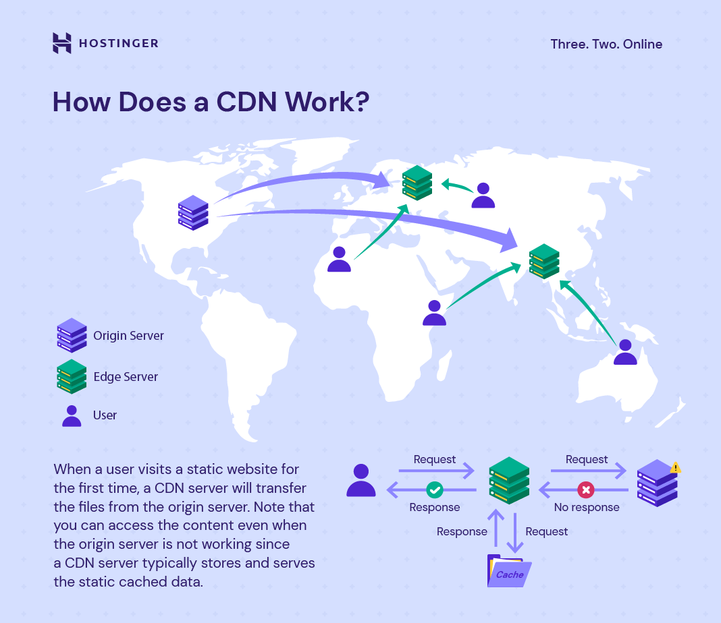

Slide 34
Benefits of using CDN
Improving website load times
Reducing bandwidth costs
Increasing content availability and redundancy
Improving website security

Slide 35
4. jQuery Selectors
Used to "find" (or select) HTML elements
based on their
name, id, classes, types,
attributes, values of attributes and much more.
All selectors in jQuery start with
the dollar sign and parentheses: $().

Slide 36
$(document).ready(function(){
$("button").click(function(){
$("p").hide();
});
});

Slide 37
The .class Selector : $(".test")
The #id Selector : $("#test")
The element Selector : $("p")

Slide 38
Syntax | Description
$("*") | Selects all elements
$(this) | Selects the current HTML element
$("p.intro") | Selects all <p> elements with class="intro"
$("p:first") | Selects the first <p> element
$("ul li:first") | Selects the first <li> element of the first <ul>
$("ul li:first-child") | Selects the first <li> element of every <ul>
$("[href]") | Selects all elements with an href attribute
$("a[target='_blank']") | Selects all <a> elements with a target attribute value equal to "_blank"
$("a[target!='_blank']") | Selects all <a> elements with a target attribute value NOT equal to "_blank"
$(":button") | Selects all <button> elements and <input> elements of type="button"
$("tr:even") | Selects all even <tr> elements
$("tr:odd") | Selects all odd <tr> elements

Slide 39
5. jQuery input vs :input
<html> <head> <script src="https://ajax.googleapis.com/ajax/libs/jquery/3.7.1/jquery.min.js"></script>
<script> $(document).ready(function(){
$(":input").css("background-color", "red");
}); </script> </head> <body>
<form action="">
Name: <input type="text" name="user"><br>
Password: <input type="password" name="password"><br>
<textarea> abcde </textarea> <br>
<input type="reset" value="Reset"> <input type="submit" value="Submit"><br>
</form> </body> </html>

Slide 40
5. jQuery input vs :input
<html> <head> <script src="https://ajax.googleapis.com/ajax/libs/jquery/3.7.1/jquery.min.js"></script>
<script> $(document).ready(function(){
$("input").css("background-color", "red");
}); </script> </head> <body>
<form action="">
Name: <input type="text" name="user"><br>
Password: <input type="password" name="password"><br>
<textarea> abcde </textarea> <br>
<input type="reset" value="Reset"> <input type="submit" value="Submit"><br>
</form> </body> </html>

Slide 41
Feature | $(input) | $(:input)
Target | Only <input> elements | <input>, <textarea>, <select>
Type | Standard CSS selector | jQuery-specific selector
Performance | Generally faster | Can be slower, especially in large documents
Specificity | More specific (only input tags) | Less specific (all form controls)

Slide 42
used to create a drop-down list.
used in a form, to collect user input.
<label for="cars">Choose a car:</label>
<select name="cars" id="cars">
<option value="volvo">Volvo</option>
<option value="saab">Saab</option>
<option value="mercedes">Mercedes</option>
<option value="audi">Audi</option>
</select>

Slide 43
6 jQuery DOM manipulation methods
Method | Description
append() | Inserts content to the end of element(s) which is specified by a selector.
before() | Inserts content (new or existing DOM elements) before an element(s) which is specified by a selector.
after() | Inserts content (new or existing DOM elements) after an element(s) which is specified by a selector.
prepend() | Insert content at the beginning of an element(s) specified by a selector.
remove() | Removes element(s) from DOM which is specified by selector.
replaceAll() | Replace target element(s) with specified element.
wrap() | Wrap an HTML structure around each element which is specified by selector.

Slide 44
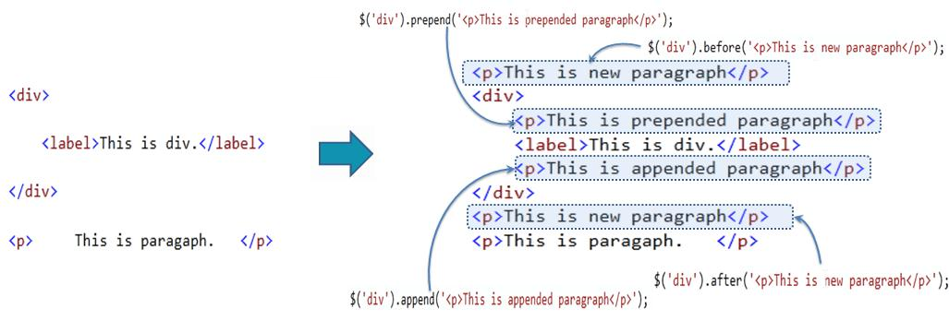

Slide 45
<body>
<h2>Remove an HTML Element</h2>
<p id="id01">Hello World!</p>
<p id="id02">Hello Sweden!</p>
<script> $(document).ready(function() { $("#id02").remove(); }); </script> </body>

Slide 46
<body>
<h2>Remove an HTML Element</h2>
<p id="id01">Hello World!</p>
<p id="id02">Hello Sweden!</p>
<script> document.getElementById("id02").remove(); </script>
</body>

Slide 47
replaceAll()
<script> $(document).ready(function(){
$("button").click(function(){
$("<h2>Hello world!</h2>").replaceAll("p");
}); }); </script>
</head>
<body>
<button>Replace all p elements with h2 elements</button><br>
<p>This is a paragraph.</p> <p>This is another paragraph.</p> <p>This is another paragraph.</p>
</body>

Slide 48
wraps specified HTML element(s)
<script> $(document).ready(function(){ $("button").click(function(){ $("p").wrap("<div></div>");
}); }); </script>
<style> div{background-color: yellow;} </style>
</head>
<body> <p>This is a paragraph.</p> <p>This is another paragraph.</p>
<button>Wrap a div element around each p element</button>
</body>

Slide 49
7 jQuery Elements
<body>
<p id="01">Hello World!</p> <p id="02">Hello Class!</p>
<script>
$(document).ready(function() {
var myElement = $("#01");
myElement.text("Hello Dear!");
}); </script>
</body>
Set Text Content

Slide 50
<body>
<p id="01">Hello World!</p> <p id="02">Hello LPU!</p>
<p id="03">Hello Class!</p> <p id="demo"></p>
<script>
$(document).ready(function() {
var myText = $("#02").text();
$("#demo").text(myText);
});
</script> </body>
Get Text Content

Slide 51
<body>
<div id="01"><p>Hello World!</p></div> <div id="02"><p>Hello LPU!</p></div>
<script>
$(document).ready(function() {
var content = $("#02").html();
$("#01").html(content);
});
</script> </body>
In JavaScript:
content = myElement.innerHTML;

Slide 52
8 Working with JSON Objects
JSON: JavaScript Object Notation
JSON Object Literals: '{"name":"John", "age":30, "car":null}'
JSON object literal: {"name":"John", "age":30, "car":null}
literals are surrounded by curly braces {}.
contains key/value pairs.
Keys and values are separated by a colon.

Slide 53
8.1 about JSON
stands for JavaScript Object Notation
a lightweight data-interchange format
plain text written in JavaScript object notation
used to send data between computers
language independent *
possible to store JavaScript objects as text.

Slide 54
8.2 JSON rules
Malformed JSON strings that can cause an exception
{id: 01} // The attribute name must be double-quoted
{'id': 01} // The attribute name must be double-quoted
instead of single quotation
{"name": 'john'} // value is a string so, it must be double-quoted
".7" //A number must start with a digit.
We can write "0.7"

Slide 55
8.3 JSON syntax
JSON Syntax Rules
Data is in name/value pairs
Data is separated by commas
Curly braces hold objects
Square brackets hold arrays

Slide 56
8.4 Working with JSON Objects exe
<html> <head>
<script src = "https://ajax.googleapis.com/ajax/libs/jquery/3.5.1/jquery.min.js"> </script>
</head> <body> <p id = "p1"> </p> <button> Click me </button> <p id = "p2"> </p>
<script>
$(document).ready(function(){ var json = '{ "name": "Alex", "age": 23}’;
var emp = jQuery.parseJSON(json); //JSON.parse() converts JSON strings to JavaScript objects
$("#p1").html("The passed JSON string is: <b>" + json + "</b>"); $("button").click(function() {
$("#p2").html("<b> Name: </b>" + emp.name + "<br> <b> Age: </b>" + emp.age );
}); });
</script> </body> </html>
Notes:
https://www.javatpoint.com/jquery-parsejson-method

Slide 57
9. JSON Arrays
Arrays in JSON are almost the same as arrays in JavaScript.
JSON array literal ["Ford", "BMW", "Fiat"]
create a JavaScript array by parsing a JSON string
myJSON = '["Ford", "BMW", "Fiat"]’;
myArray = JSON.parse(myJSON);

Slide 58
9.1 JSON array implementation
<p id="demo"></p>
<script>
const myJSON = '{"name":"John", "age":30, "cars":["Ford", "BMW", "Fiat"]}';
const myObj = JSON.parse(myJSON);
document.getElementById("demo").innerHTML = myObj.cars[0];
</script>
JSON.parse() converts JSON strings to JavaScript objects

Slide 59
10. Nested JSON object
Explore JSON nested object at: https://jsoncrack.com/editor
<html> <head>
<script src = "https://ajax.googleapis.com/ajax/libs/jquery/3.5.1/jquery.min.js"> </script> </head> <body> <p id="demo"></p>
<script>
const myJSON = '{"emp": {"Aman":{"age": 30,"state":"Punjab"},"Amit":{"age": 25,"state": "HP"}}}';
const data = JSON.parse(myJSON);
document.getElementById("demo").innerText = data.emp.Aman.state;
</script> </body> </html>

Slide 60
11. Conversion of JSON object to string & string to JSON object
<script>
const myJSON = '{"emp": {"Aman":{"age": 30,"state":"Punjab"},"Amit":{"age": 25,"state": "HP"}}}’;
const myObj = JSON.parse(myJSON); // converts JSON strings to JavaScript objects
const data = JSON.stringify(myObj); // converts JavaScript objects to JSON strings
document.getElementById("demo").innerText = data;
</script>
JSON.stringify() converts JavaScript objects to JSON strings

Slide 62
12

